Slide 1


Module 2
Incident Types and Categories
What is a critical client incident?
Centre for Learning and Organisational Development
next

Slide 2



Incident Reporting Modules Explained
Hello and welcome to the on-line resources for critical client incident reporting and management. You are currently accessing Module 2.
The following information outlines the content of this module and shows which other modules are available.
Module 1 – What is incident reporting and why is it important?
Module 2 – Incident types and categories
This module outlines the types of incidents that may occur. The module also provides examples of categorising incidents and the associated timeframes for reporting incidents.
Module 3 – Completing a Client Incident Report form
At the end of each module you will be asked some multiple choice questions about what you have learnt
next

Slide 3
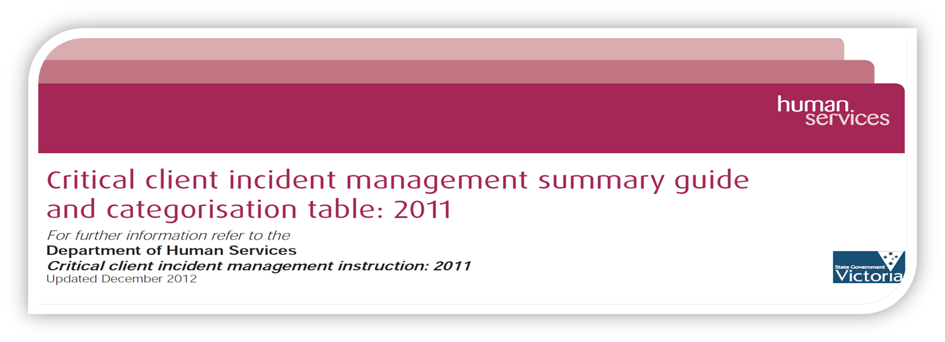

Resources
Before we start, please download a copy of the:
Critical client incident report management summary guide and categorisation table
next

Slide 4
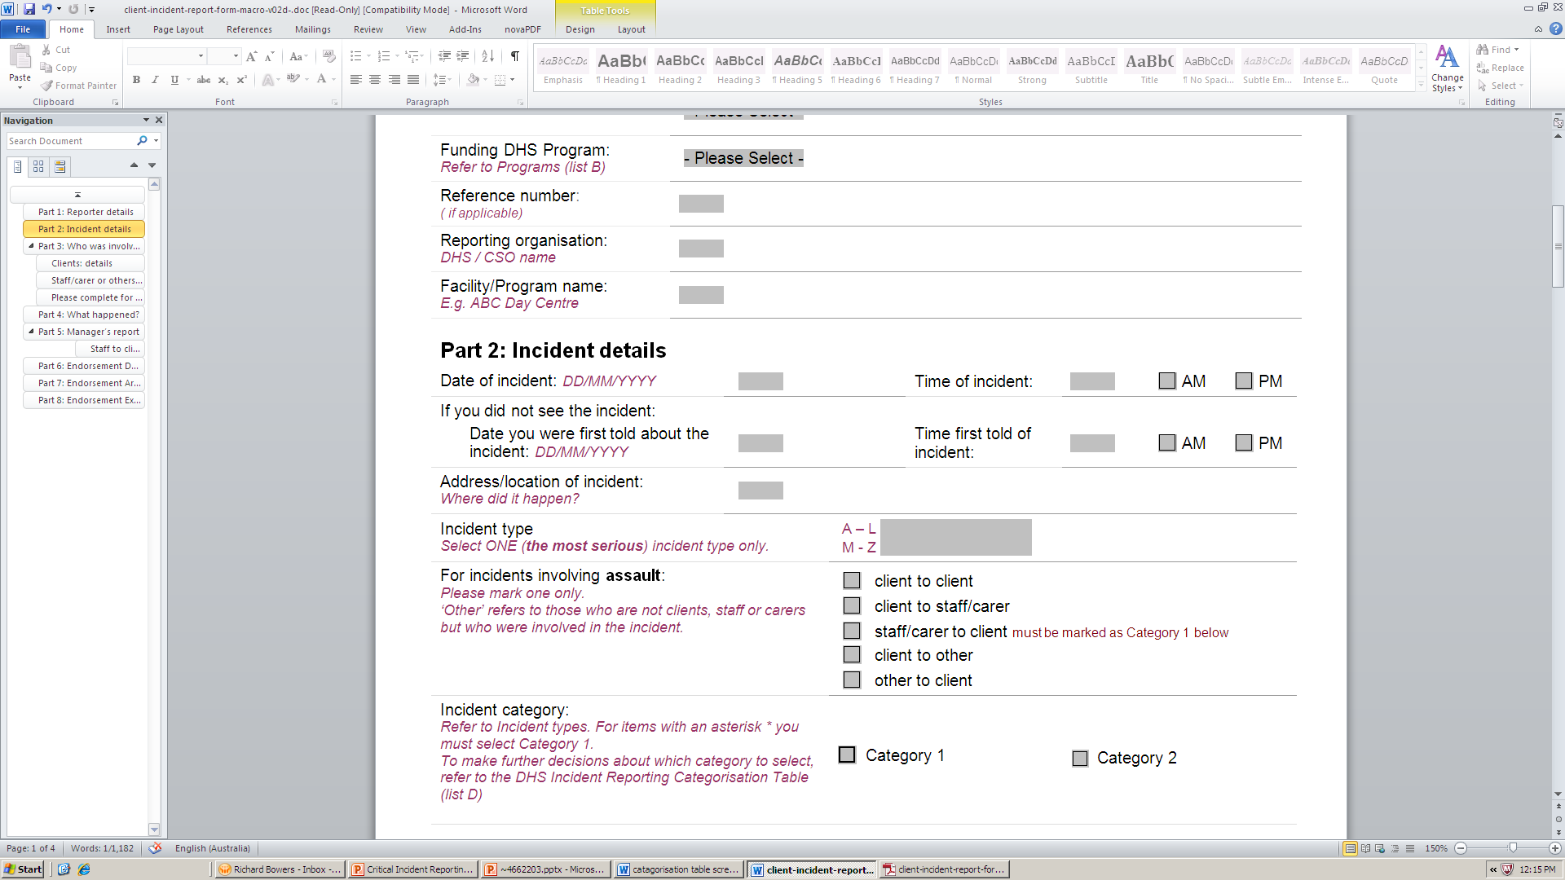
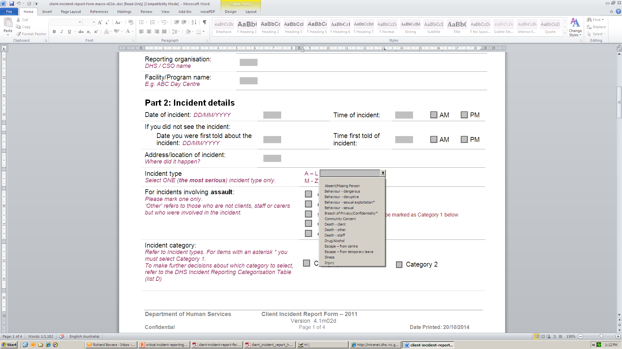
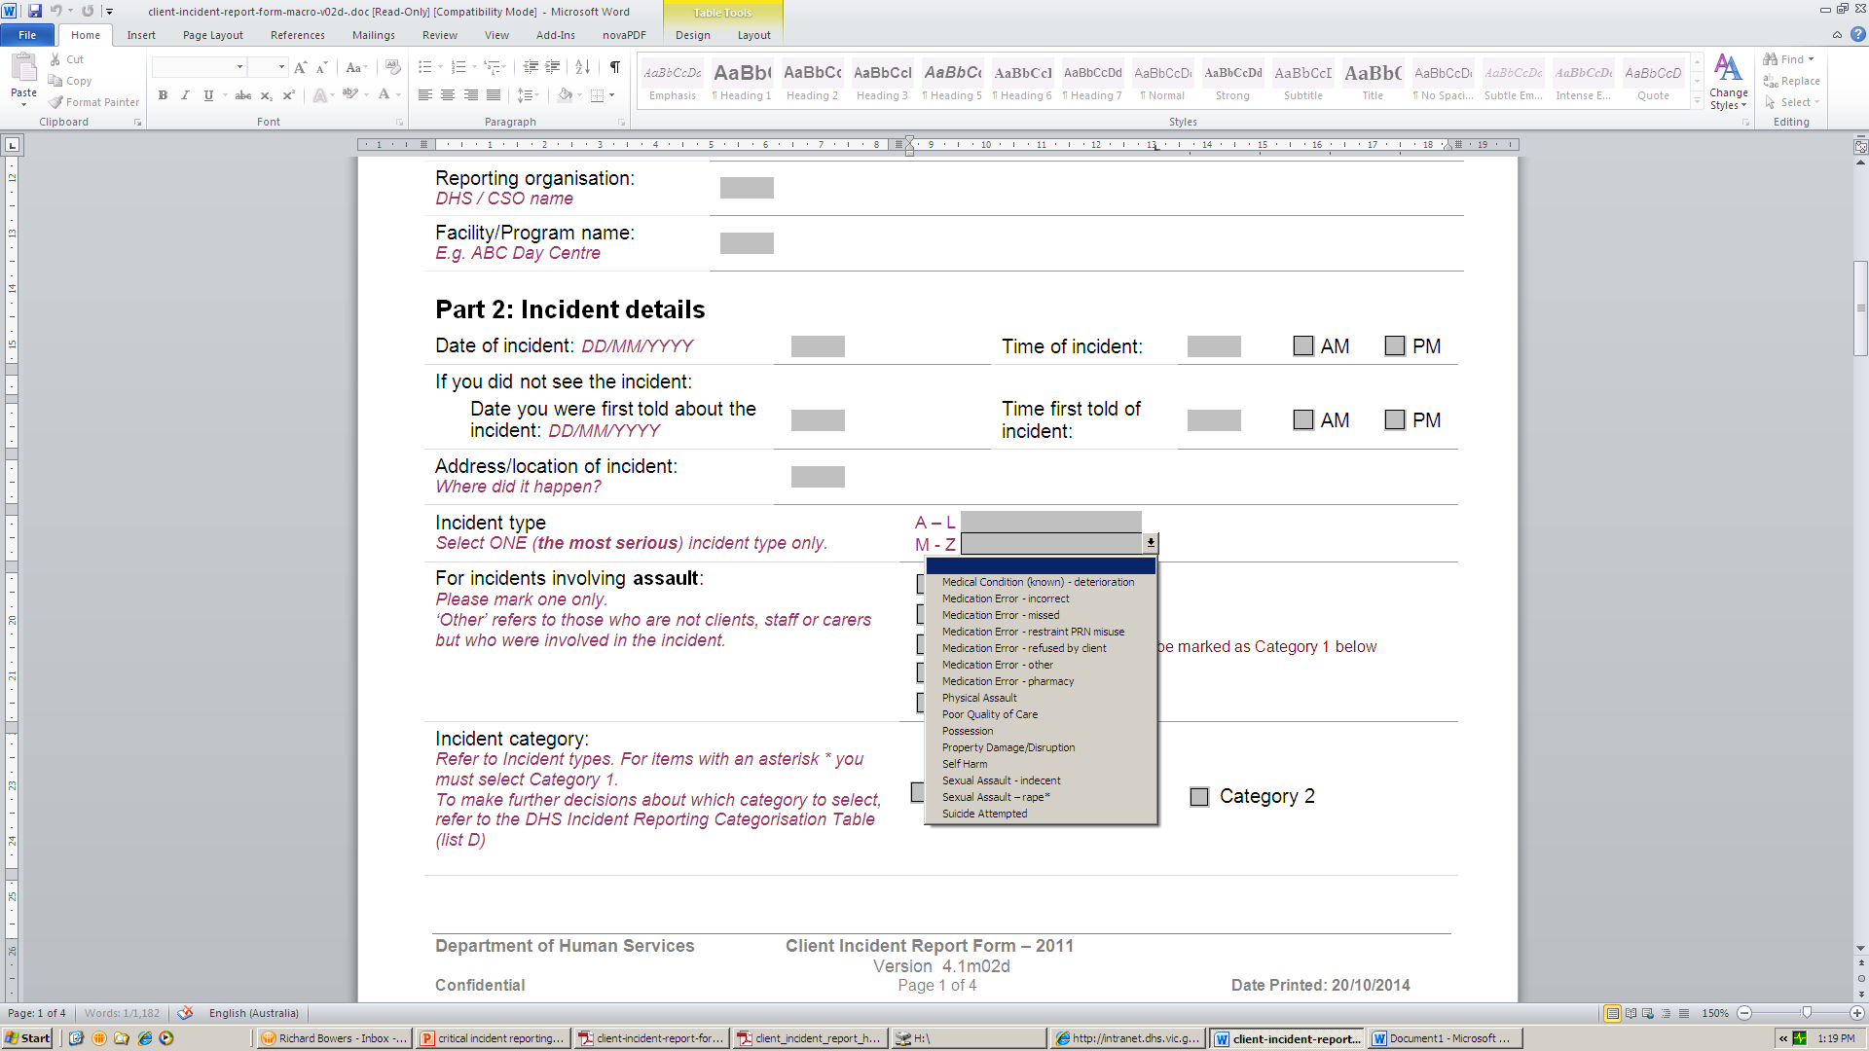

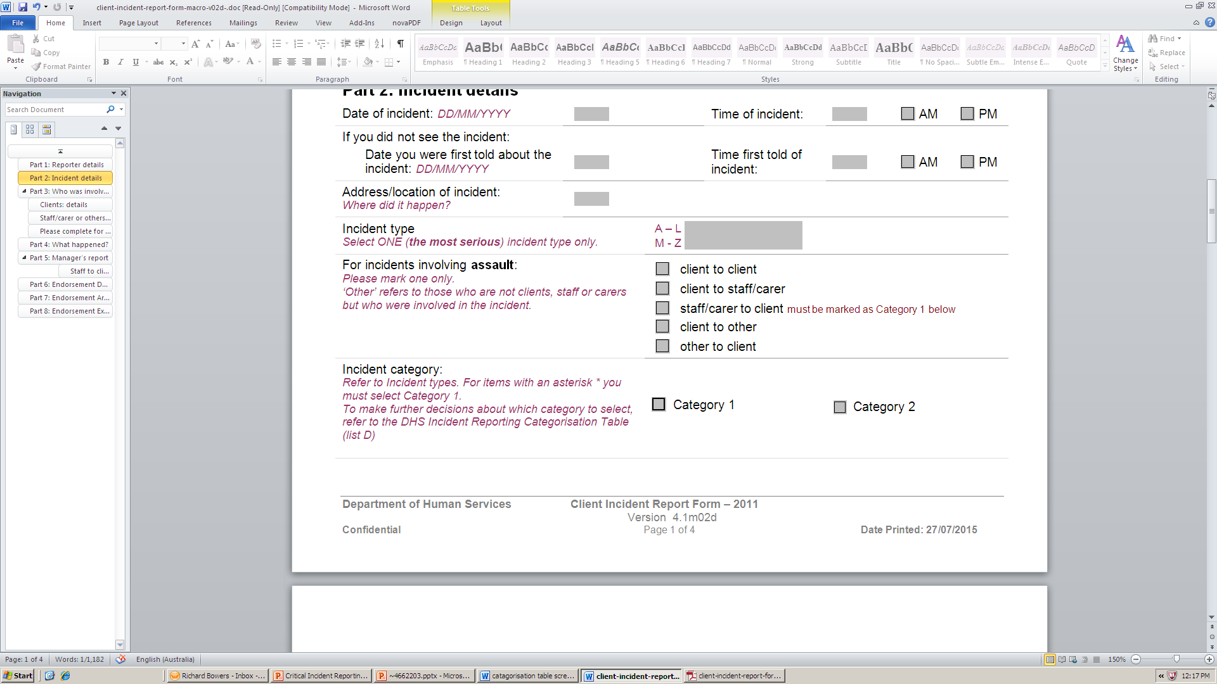
Incident types and categories
When completing a Client Incident Report form, you will need to select an:
Incident type
Complete this section if the incident involved an assault
and category
next

Slide 5
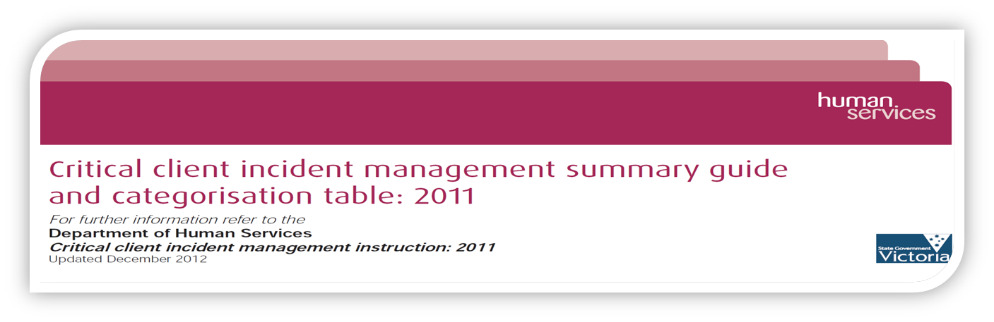

Incident types
An incident type describes what happened.
For each incident, choose one incident type.
There is a set list of incident types to choose from.
All of the incident types are outlined in the
Critical client incident management summary guide and categorisation table.
next

Slide 6



Incident types
During an incident, a number of serious events may occur.
When choosing an incident type, choose the incident type that
best describes the incident, behaviour or circumstances that had the greatest impact.
Incident example: a Support Worker intervenes to stop two clients fighting. During the incident, a window is broken.
Physical Assault
Incident that had the greatest impact
Property damage/disruption
next

Slide 7




Incident types
It’s not possible to list
every possible incident
Property damage/disruption
Illness
Drug/alcohol
Breach of privacy confidentiality matters
Poor quality of care
Medication error
Absent/missing persons
Sexual assault
Behaviour
Injury
Escape
Self harm
Possession
Use your professional judgement to chose the incident type.
If you’re unsure, consult your Manager.
Death
Community concern
Physical assault
Medical condition known – deterioration
Suicide attempted
next

Slide 8



Categories
Each incident also needs to be categorised according to the impact it has on the client or others, or the potential risk to client or others.
There are two categories
Category
Category
and
next

Slide 9
Category One incidents
Category 1 is for the
most serious incidents:
Incidents that result in
serious outcomes or trauma.
Category 1 incidents must be reported as soon as possible and within one working day.
next

Slide 10
Incident reporting timelines
Category 1 incident reports must be lodged with DHHS
within one working day.
This means that if a service provider is delivering a service for
24 hours a day, 7 days a week,
the incident report is required by the following day.
If a service provider is delivering a service from Monday to Friday, the incident report is required by the next business day.
next

Slide 11

Category Two incidents
Category 2 is for
other incidents:
Incidents that threaten the health, safety and/or
wellbeing of clients and others.
Category 2 incidents must be reported as soon as possible and within
two working days.
next

Slide 12
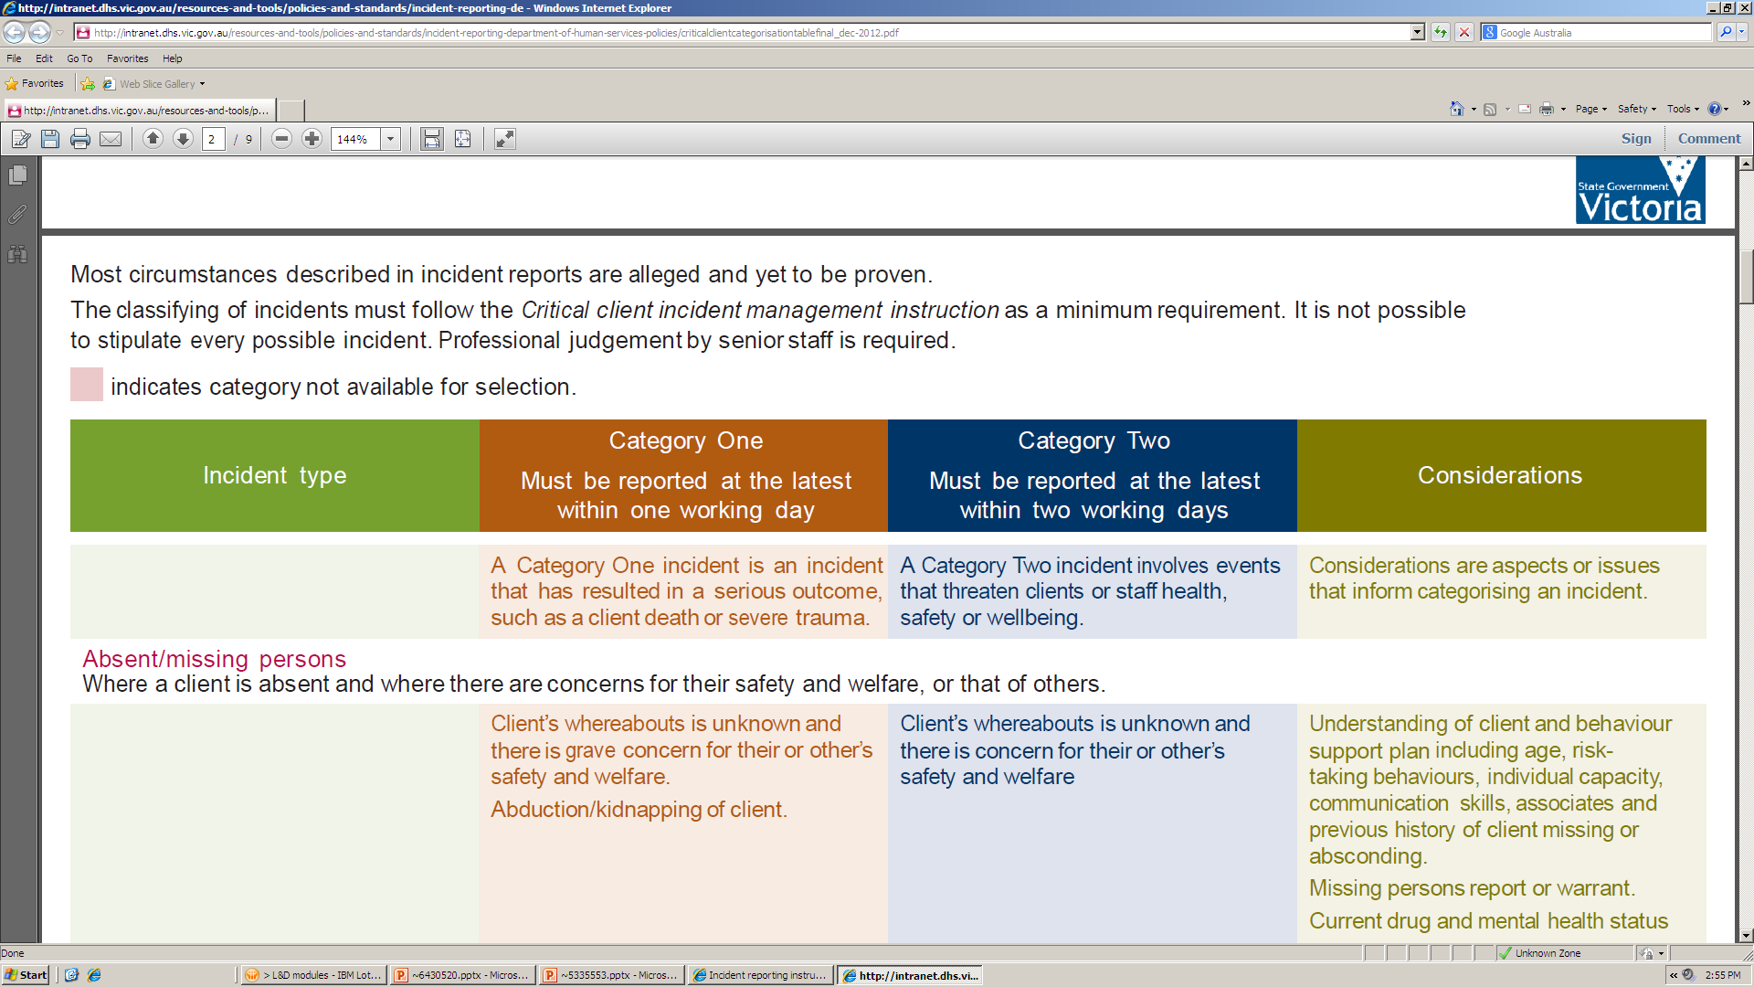
Definitions
The Critical client incident management summary guide and categorisation table will help you choose an incident type and category.
It provides a definition for each incident type and examples of
Category 1 and Category 2 incidents within that incident type.
next

Slide 13


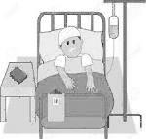
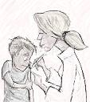
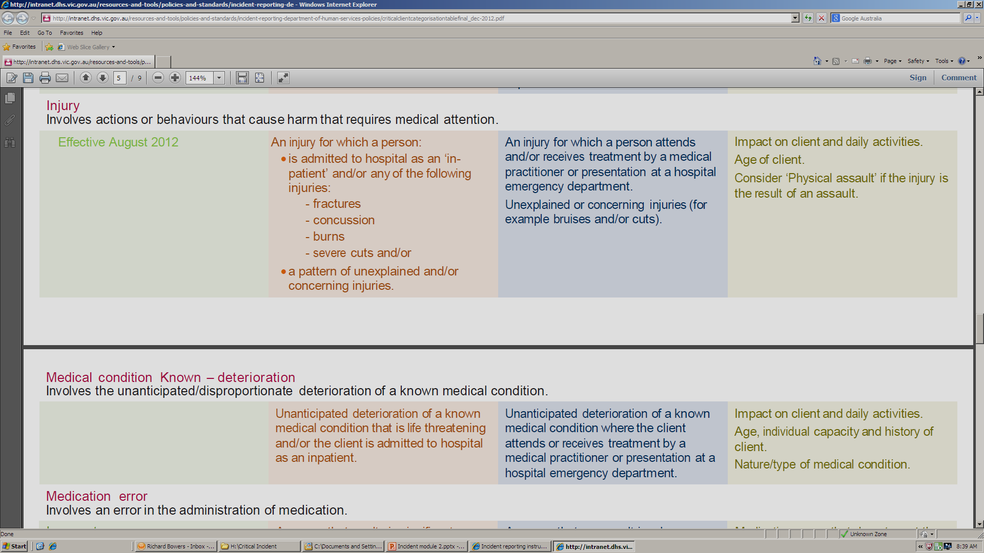
Definitions of Incident and Category
Let’s use the categorisation table to define an incident and category
Person is admitted to hospital due to fractures
Person seen by a local doctor after falling off a bike and cutting his/her arm
Incident type
Injury
Category One
Category Two
next

Slide 14






Allegations of Assault
If the incident involves an allegation of assault, refer to the:
Responding to allegations of physical or sexual assault instruction technical update 2014.
This instruction outlines the reporting and management requirements for all allegations of assault,
including the mandatory requirement to
report assaults to Victoria Police.
All allegations of assault of a client by a staff member must be reported to Victoria Police.
next

Slide 15





Further information
You can find out more by:
Talking with your manager
Reading your organisation’s policies and procedures for incident reporting
Looking at the _x000b_Critical Client Incident Management Instruction
and support materials on the
Funded Agency Channel
next

Slide 16
Test your understanding
Your manager should now provide you with a worksheet with multiple choice questions on the information you just learned.
Please complete the sheet promptly.
Thank you

Slide 17
To receive this publication in an accessible format phone 1300 799 470 select support option 1( for assistance with ebusiness),then select option 5 for funded agency channel, using the National Relay Service 13 36 77 if required, or email fac@dhs.vic.gov.au
Authorised and published by the Victorian Government, 1 Treasury Place, Melbourne.
© State of Victoria, Department of Health and Human Services February, 2016
Except where otherwise indicated, the images in this publication show models and illustrative settings only, and do not necessarily depict actual services, facilities or recipients of services.
Available at www.dhs.vic.gov.au/funded-agency-channel/about-service-agreements/incident-reporting

